Slide 1






AI-Powered MQS Code Static Validation
AI AGENT · MQS CODE STATIC VALIDATION AGAINST RAML
From Manual Effort to Intelligent Automation
Reduce manual effort
90%+ validation accuracy
Accurate mismatch identification
Report in ~10–20 minutes
MQS Mapping (Excel)
AI Validation Agent
Validation Report + Human Review
+
Field-by-field PASS / FAIL, verified by a reviewer
RAML conversion + rule-driven validation
RAML specification
Notes:
Welcome. This project is an AI agent that validates an MQS Mapping Document (Excel) against its RAML API specification. Today's story: the manual problem, the three input files, Stage 1 where the RAML is converted into a compact key-value format, Stage 2 where the validation agent compares the mapping against it using a final master prompt, the validation conditions and the report, and finally the human review that keeps the result reliable. The outcome is a field-by-field report in roughly 10 to 20 minutes with over 90 percent validation accuracy on our current results.

Slide 2


Manual validation is slow and error-prone
01 · THE PROBLEM
1
2
3
4
5
Excel review
RAML lookup
Field-by-field comparison
Mismatch identification
Report preparation
MQS Mapping Document (Excel)
250+
5+
Path name
Field name
Data type
Orchestration
datasets may need validation
people can review the same Excel
Other validation attributes
Time-consuming checking: 3–4 days (≈24–32 hours)
RAML specification
Repetitive checks and high human effort
API paths
Variables
Data types
Structures
Descriptions
Risk of human error and missed mismatches
Required / optional
Several reviewers tied up on one Excel
Hard to keep results consistent
AI-Powered MQS Code Static Validation
2 / 7
Notes:
This is the baseline. A reviewer opens the MQS Mapping Document, looks up each interface in the RAML, compares field by field, identifies mismatches and prepares the report by hand. The Excel carries path name, field name, data type and the mandatory or optional flag; the RAML carries API paths, variables, data types, structures, descriptions and required flags. More than 250 datasets may need validation and more than five people can be involved in reviewing one Excel. The limitations are time, repetitive field-by-field checking, human effort and the possibility of errors. These numbers describe the scale of the effort as reported by the team.

Slide 3
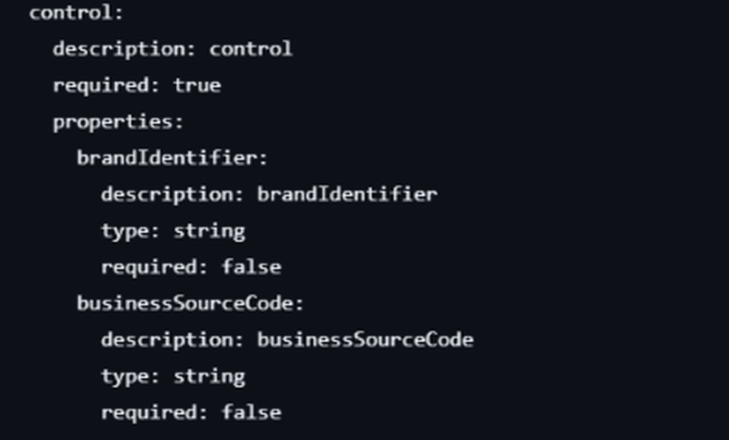
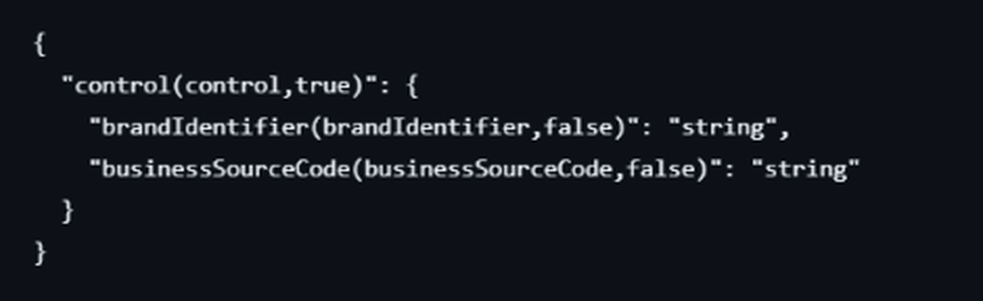
Three inputs drive the validation
02 · INPUT FILES
1
MQS Mapping Document
2
Static Document RAML File
3
Compact RAML (TXT)
.xlsx · client mapping sheet
.raml / .yaml · static document
.txt · output of Stage 1
Path
Field name
Type
Flag
control
brandIdentifier
string
Optional
control
businessSourceCode
string
Optional
control
channelCode
string
Mandatory
order[]
quantity
integer
Mandatory
ILLUSTRATIVE
WHAT IT CONTAINS
WHY CONVERT IT
WHAT WE GET
Interface path, field name
Verbose, nested YAML
One compact line per field
Data type
Type and required per field
Hierarchy and arrays kept
Mandatory / Optional flag
Hard to compare at scale
Easy field-by-field compare
AI-Powered MQS Code Static Validation
3 / 7
Notes:
Three files drive the whole workflow. First, the MQS Mapping Document in Excel: it lists the interface path, field name, data type and the mandatory or optional flag for every field. Second, the static document RAML file, the static API specification. It is a nested YAML structure that contains each field's description, type and required flag, but it is verbose and hard for a model to compare at scale. Third, the compact key-value RAML, a text file produced in Stage 1 from the static document RAML file. The Excel preview on the left is an illustrative layout; the two RAML screenshots are from our conversion prompt example.

Slide 4
End-to-end validation architecture
03 · AGENT ARCHITECTURE
INPUT LAYER
STAGE 1
NORMALIZED INPUTS
STAGE 2
OUTPUT
HUMAN REVIEW
X
Conversion Agent
MQS Mapping Excel
Validation Agent
✓
H
MQS Mapping Document
Mapping sheet and relevant columns identified
Field-by-field Validation Report
Human-in-the-loop
Conversion prompt + one-shot
Final master prompt
.xlsx
Converts RAML to compact key-value TXT
Keeps hierarchy, names, types, required flags, arrays
No validation here
Interface path
Field name / tag
Data type
Required / optional
Also: missing fields, nesting, arrays, 1-to-1 match
PASS / FAIL per field
Detected mismatches
Missing-field flags
Issue descriptions
Verifies findings
Resolves ambiguities
Confirms final report and signs off
R
Compact RAML TXT
Static Document RAML File
RAML structure retained
.yaml / .raml
AUTOMATED · AI agent runs both stages · ~10–20 minutes
VERIFIED BY HUMAN
Two-stage design · Deterministic rules · Source content preserved · Human oversight · Reusable for other mapping documents and RAML specs
AI-Powered MQS Code Static Validation
4 / 7
Notes:
This is the full architecture. The input layer is the MQS Mapping Document in Excel and the static document RAML file. Stage 1 is the RAML conversion agent: a conversion prompt with a one-shot example turns the RAML into a compact key-value text file, preserving hierarchy, field names, descriptions, data types, required flags and arrays, and doing no validation. The normalized inputs are the mapping Excel plus the compact RAML text. Stage 2 is the validation agent: the final master prompt compares interface path, field name, data type and required or optional status, and also checks missing fields, nested objects, arrays and one-to-one matching. The output is a field-by-field PASS or FAIL report with mismatches, missing-field flags and issue descriptions. Finally a human reviews the findings, resolves ambiguities and confirms the report. The design is two-stage, rule-driven, preserves the source and is reusable for other mapping documents and RAML specs.

Slide 5
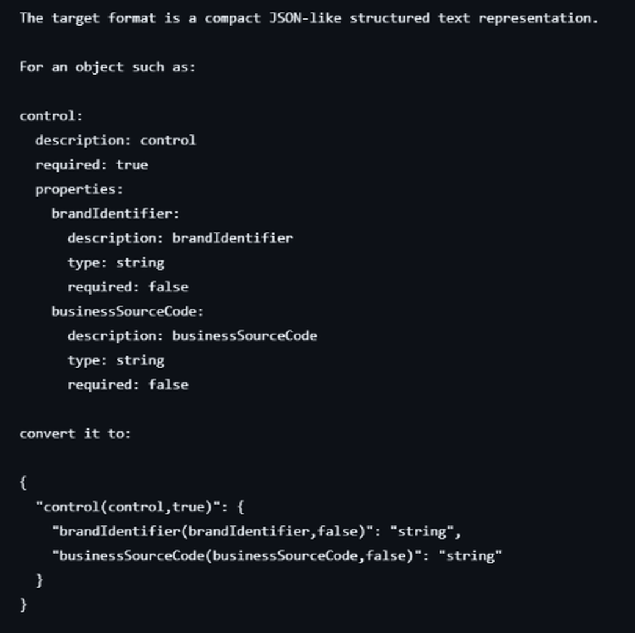
From static RAML to compact key-value format
04 · STAGE 1 · RAML CONVERSION
1
Input: static document RAML file
SCREENSHOT · CONVERSION PROMPT WITH ONE-SHOT EXAMPLE
Static, nested YAML with description, type and required for every property.
2
Conversion prompt + one-shot example
BEFORE
The prompt defines the target format and shows one worked object, so the model repeats the pattern for the whole spec.
Static document RAML file
3
Output: compact key-value TXT
One line per field with its type; hierarchy and arrays are preserved.
AFTER
Compact key-value format
Format: "name(description,required)": "type"
AI-Powered MQS Code Static Validation
5 / 7
Notes:
Stage 1 converts the static document RAML file into a compact key-value format. We do it with a conversion prompt that uses one-shot prompting: the prompt describes the target format and includes one worked example. In the screenshot you can see the static document RAML file object, control, with its properties brandIdentifier and businessSourceCode, each with description, type and required. Below it is the converted result, where every field becomes one line in the form name, description and required flag, mapped to its type. The principle is to preserve the source content and hierarchy and to perform no validation at this stage.

Slide 6
Validation agent, conditions and report
05 · STAGE 2 · VALIDATION AGENT
MQS Mapping Excel
Compact RAML TXT
Validation Agent
Field-by-field report
+
Final master prompt + conditions
VALIDATION CONDITIONS
HOW MISMATCHES ARE REPORTED
Interface path
Mapping path vs RAML hierarchy, incl. array notation
PASS
brandIdentifier
Field name
Exact, case-sensitive match with RAML description / tag
Path, name, type and flag all match
Data type
Approved normalizations only: date-only → date, time-only → time, int → integer
FAIL
Data type mismatch
Mapping: integer · RAML: string
Mandatory / Optional
Compared with the Orchestrator column (not Pre-Comp)
Missing fields
Present in one source but absent in the other → flagged
FAIL
Missing in RAML
Field in mapping, absent in RAML: flagged
Nested & arrays
Objects, arrays and child fields validated one-to-one
Every field gets a status, expected vs actual value and an issue comment. Illustrative examples.
AI-Powered MQS Code Static Validation
6 / 7
Notes:
Stage 2 is the validation agent. It takes the MQS Mapping Excel and the compact RAML text and compares them using the final master prompt, which carries the predefined validation conditions. Interface path: the mapping path is checked against the RAML hierarchy, including array notation. Field name: exact and case-sensitive against the RAML description or tag. Data type: only approved normalizations are allowed, namely date-only to date, time-only to time and int to integer. Mandatory or optional: compared against the Orchestrator column, not Pre-Comp. Missing fields: anything present in one source but not the other is flagged. Nested structures: objects, arrays and child fields are validated one-to-one. Each field receives a PASS or FAIL status with expected and actual values and an issue comment. The examples on the right are illustrative.

Slide 7
Automated comparison, human sign-off
06 · HUMAN-IN-THE-LOOP & BENEFITS
AI agent
Human reviewer
Final sign-off
Automates the field-by-field comparison and generates the report
Verifies important mismatches and resolves ambiguities
Reviewer confirms the report before it is shared
10–20 min
90%+
24–32 hrs
Automated processing per file
Validation accuracy, current results
Saved per process: 3–4 days → 1 day
Manual validation: 3–4 days (≈24–32 hours)
AI validation: about 1 day
Core validation: 2–3 days (16–24 hours)
Agent run: around 10–20 minutes
Plus 1–2 days (8–16 hours) if stakeholder clarification is needed
Excludes stakeholder response time
Less repetitive checking · Consistent rule-driven checks · Human review retained · Reusable prompts · Repeatable workflow
Note: 90%+ reflects current results, not a guarantee; human review closes the gap. Hours assume 8-hour working days.
AI-Powered MQS Code Static Validation
7 / 7
Notes:
The agent automates the comparison and generates the field-by-field report, but a human reviewer verifies the important mismatches and signs off. Time saving: manual validation takes 2 to 3 days, which is 16 to 24 hours, plus 1 to 2 days, or 8 to 16 hours, when stakeholder clarification is needed; the overall effort is about 3 to 4 days, roughly 24 to 32 hours. AI validation takes around 10 to 20 minutes for the agent run, excluding stakeholder response time, bringing the process to about 1 day. That is roughly 24 to 32 hours saved per process. Hours assume 8-hour working days. Accuracy is over 90 percent on current results, not a guarantee, which is why human review stays in the loop.

